Slide 1
SmoothieVendⓇ
Krishnateja Pemmaraju Rushaabh Saliya ChristieLynne Williamson

Slide 2
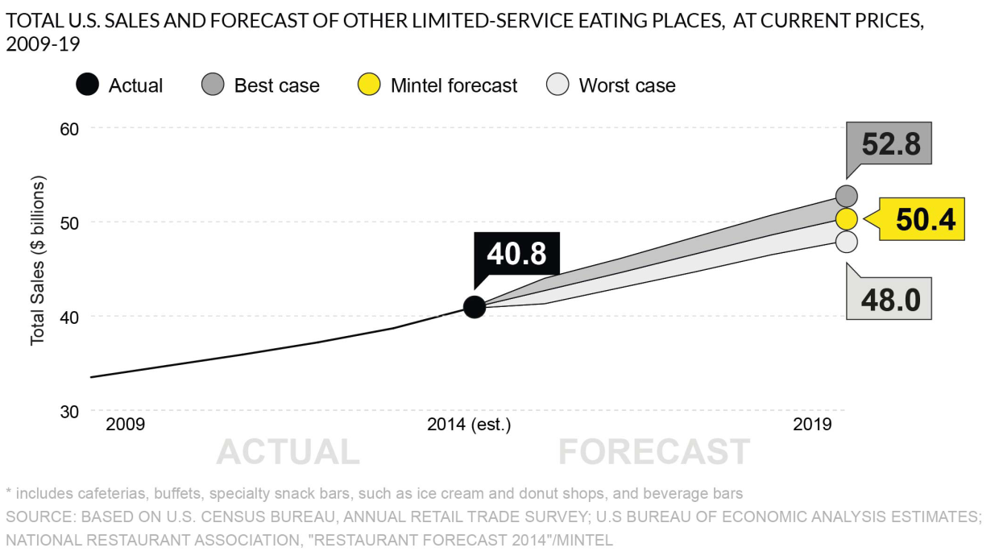
Industry Analysis
The “Beverage Bar” category has grown from $34 billions to $41 billions in 5 years.
Projected market value by 2019 : $50 billions.
Smoothies are popular among the iGens & Millennials.

Slide 3
Industry Analysis
WHAT PEOPLE WANT ?
Affordable options
Easy to eat , non messy alternatives to eat on the go
Extensive drink customization & portioning

Slide 4
Environmental Analysis: SWOT
STRENGTHS | WEAKNESSES
Customer satisfaction Strong distribution network Performance in new market Low barriers to entry in the juice and smoothie industry | Customers may see it as a gimmick to promotes healthy drinks Cost of the smoothie Competition with established brands
OPPORTUNITIES | THREATS
Change for PFG to use differentiated pricing strategy Lower cost of product Consumers gaining more health awareness | Intense competition from other providers Bigger companies may expand Changing consumer preference due to changing interests
Notes:
Discuss points from PEST analysis
Explain SWOT in detail per the paper

Slide 5
Competitive Analysis

Slide 6
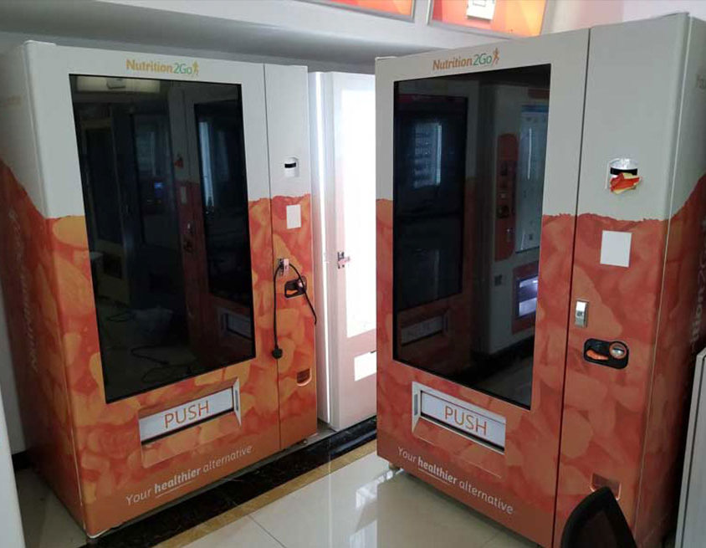
Product
Fully customizable healthy smoothies and frozen beverages
Protein, fruits, vegetables, and supplements for post-workout recovery
Dispensed in 30-60 seconds from the patented SmoothieVendⓇ frozen vending machine
Notes:
Machine pictured: Nutrition to Go

Slide 7
Place
50 Health Clubs in Miami
Mass Transit
Schools
Hospitals
Corporate Office
Notes:
Transition from the product section and explain goal of SmoothieVend.
Introduce SmoothieVend in gyms
Success of SmoothieVend will allow entry into other markets

Slide 8
Price
General smoothies will range between $3.00 to $6.00
Special blends will range between $4.00 to $6.00
Promote healthy living while providing tasty drinks!
Notes:
Discuss costs to operate the SmoothieVend
Explain cost breakdown (cost of fruits/vegetables and cost of supplements)
Talk about how our prices are set so that we can still promote healthy living while maintaining a great standard

Slide 9
Promotion
“Free Smoothie Day” program
Integrating with gym memberships

Slide 10
Advertising
Gym & health studio owners
Leverage highly trained marketing reps.
Consumers
Targeted social media ads
Print media in target rich locations

Slide 11
Public Relations
Creating Awareness for healthy living and, work & life balance
Hosting yoga sessions at various beaches in Miami.

Slide 12
Internet
“#MyFirstSip” : A multi-platform internet campaign
Health & fitness influencers
Daily vlogs & blogs

Slide 13
Goals and Projections
Approximate start-up and operating costs for the first year: $1 million
Estimated revenue: $1.5 to 2 million

